Slide 1
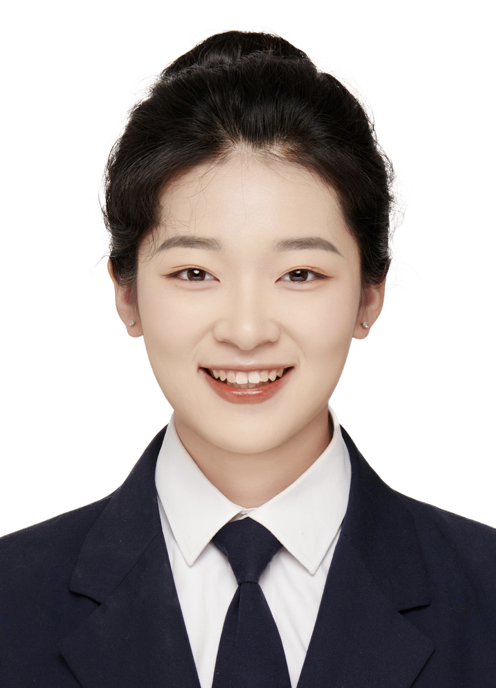
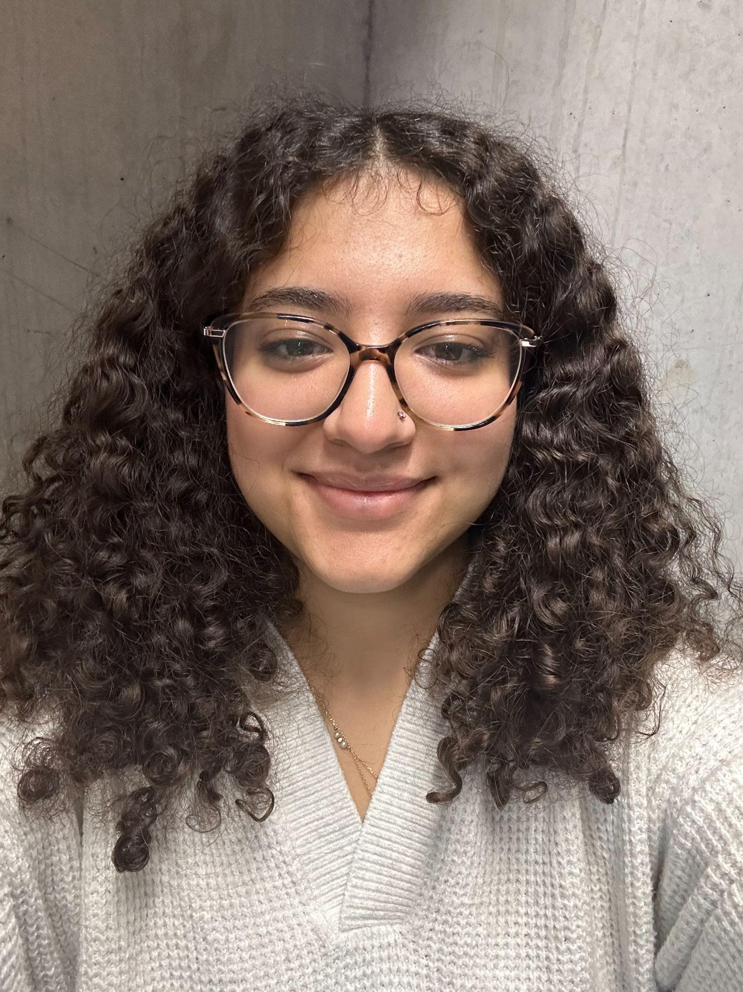
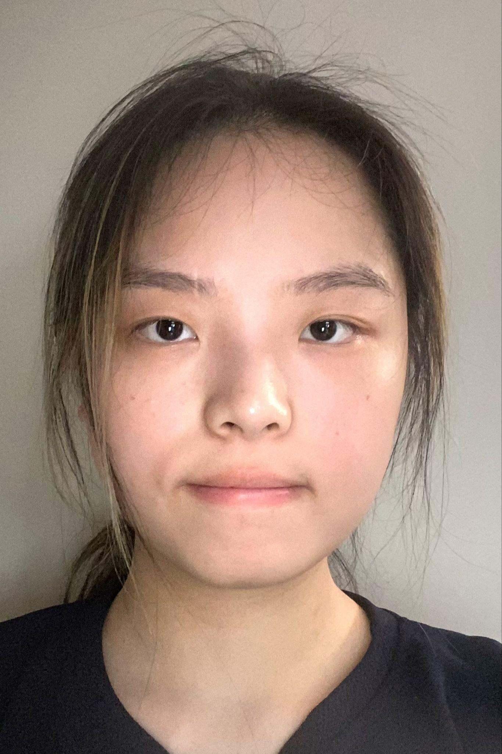
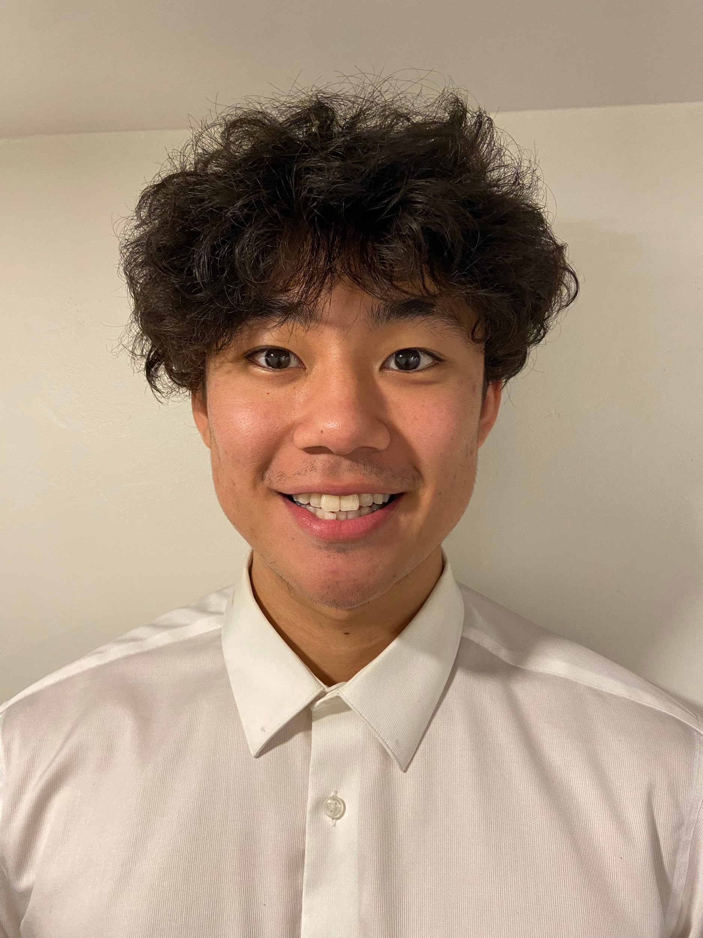
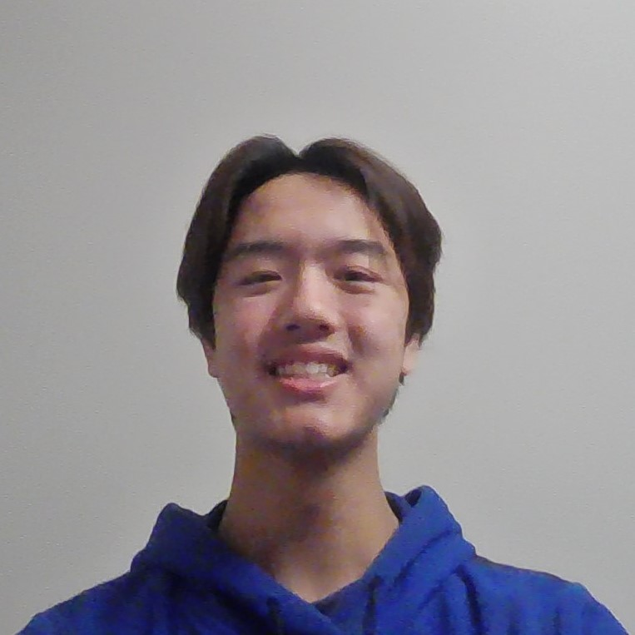
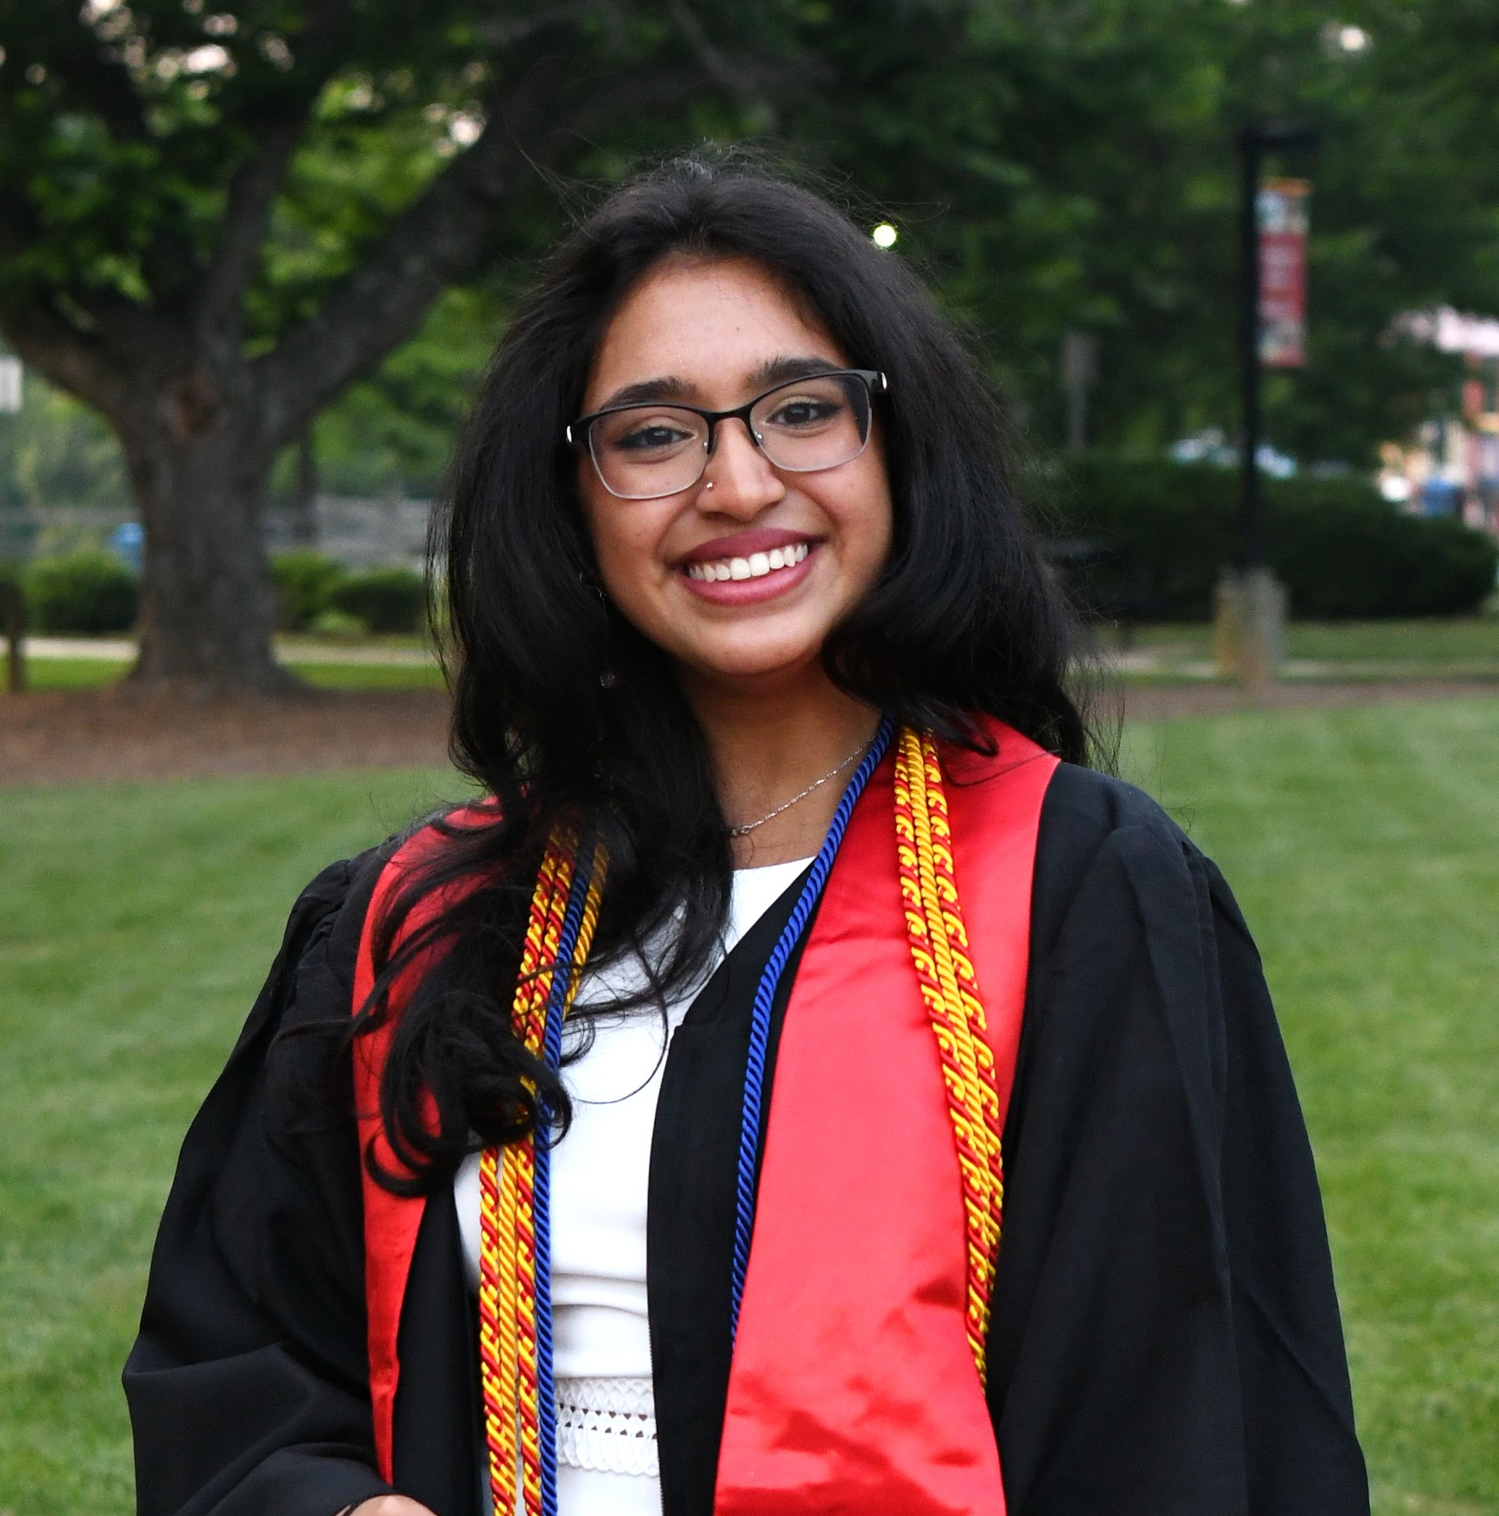
Team 095
March 13, 2024
Team Leader
Project Manager
Researcher
Secretary
Contact Manager
Editor
Lydia Messiha
Matthew Ting
Anjali Jammulamadaka
Margaret Chen
Chris Yip
Dora Lyu

Slide 2
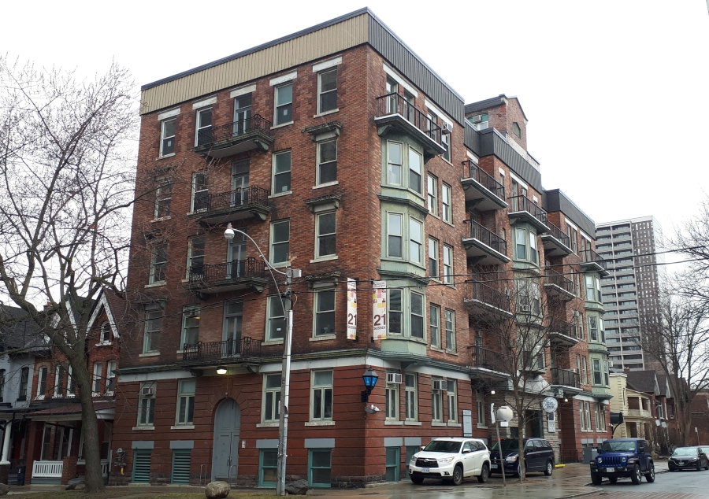
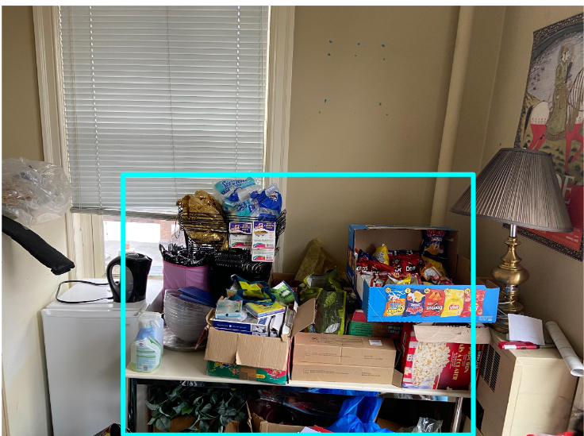
SUSSEX CLUBHOUSE SPACE AUDIT
Anjali Jammulamadaka
Client: Alyssa Ahmed
Project: Redesign the 4th, 5th, and 6th floors of the Sussex Clubhouse to provide more meeting space, better storage, and a lively community of students.
Gap: Deficiency in layout design of the space
Scope: 4th, 5th, and 6th floors
Notes:
Deficiency in layout is a hindrance to students using the space.
Meant to provide free meeting and work spaces for clubs of the University, but is failing based on client feedback.

Slide 3
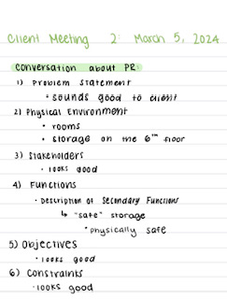
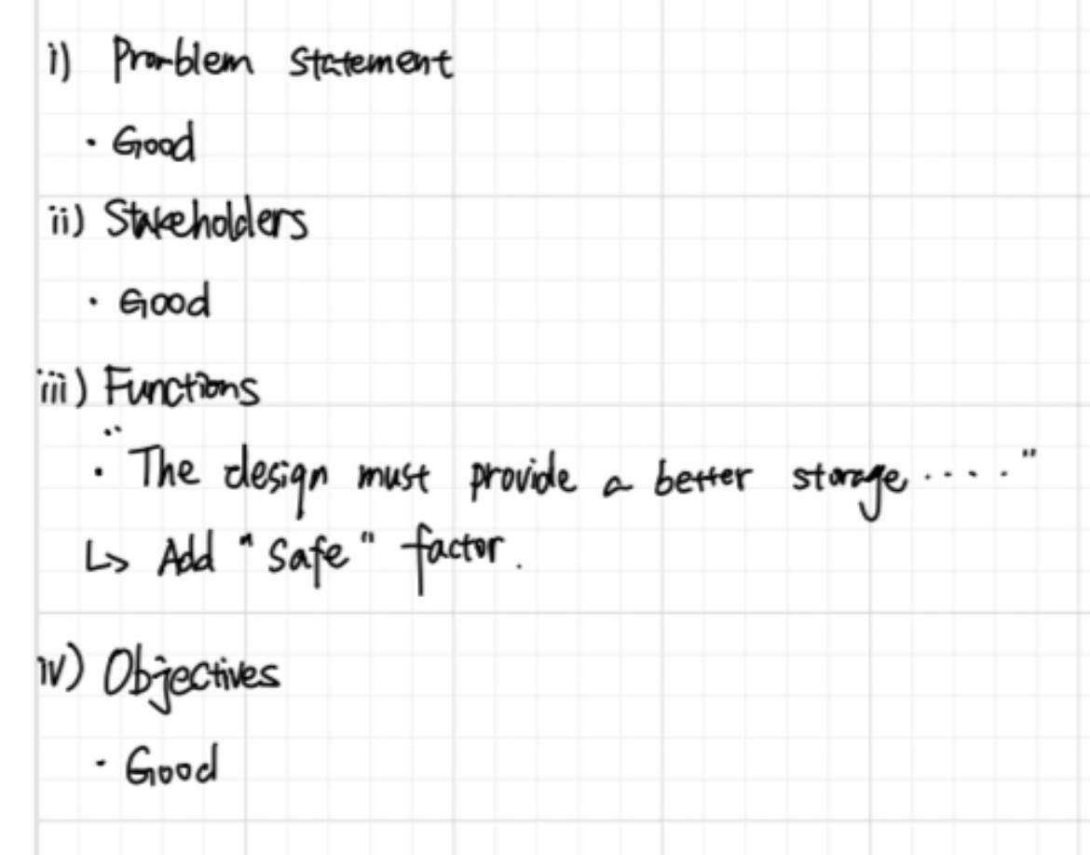
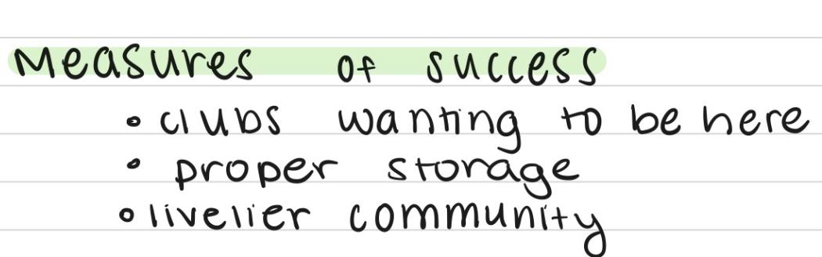
Our Project Requirements document aligns with the intended purpose of the Clubhouse and the Clients vision
Lydia Messiha and Margaret Chen
Notes:
During our Second client meeting, we went through the Project Requirements revised document with the client. We explained each part of the Project requirements and what each part meant and why they are important We highlighted portions of the PR like the: problem statement stakeholders, constraints, objectives, and functions
The feedback was positive and the client was optimistic and pleased with the revision by our team. The client was especially pleased with our problem statement, stakeholders, constraints, and objectives. We also asked the client about the measures of success we can use as we continue into idea generation to help us keep her vision and goals of the Clubhouse in mind
Review :
Meeting went well
Went through full document
Client seemed pleased
Feedback
Pictures of client notes

Slide 4
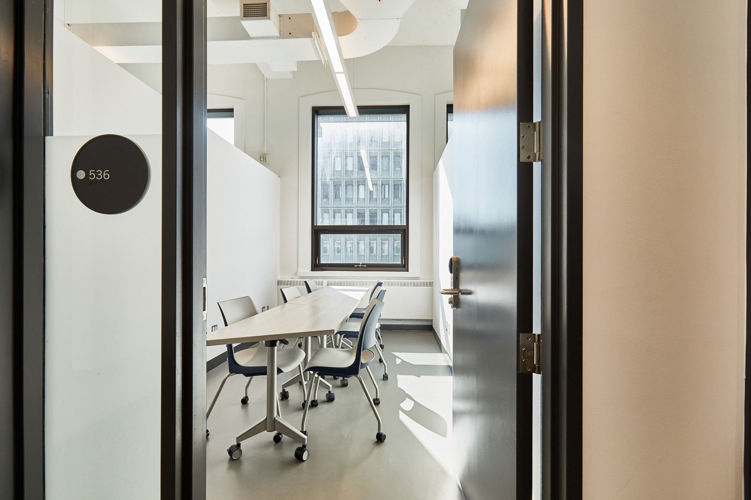
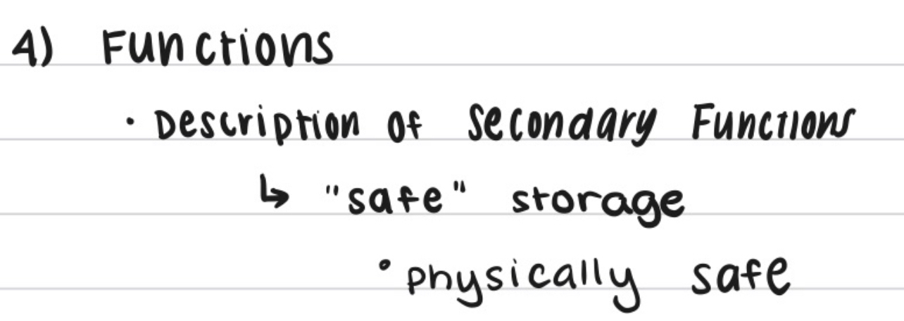
This allows us to move forward with the next phase of design
Lydia Messiha and Margaret Chen
Survey added according to Client discussion and recommendation
More measurements of cabinets that are used for storage
UTSU Building Uoft
Notes:
Revisions
Fix functions
Add survey
Add measurements of the cabinets that are used for storage
Utsu benchmarking
During the client meeting We proposed the idea of conducting a survey to send out to the separate teams, the client agreed that this was a beneficial way to gauge what every club was feeling.
We also took more measurements of the cabinets
The client gave us recommendations to firstly adjust our functions to include the storage being “safe”. The clubhouse is meant to function as a safe space for students, faculty and their belongings.
The client has also recommended we include benchmarking at the UTSU building which is the student commons building replicating a building like sussex clubhouse that she felt was

Slide 5
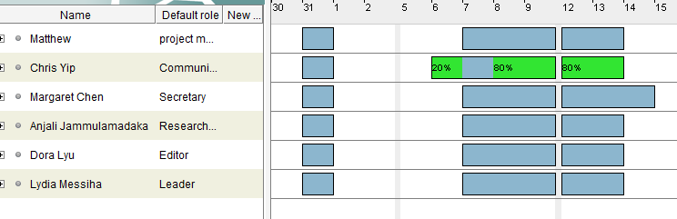
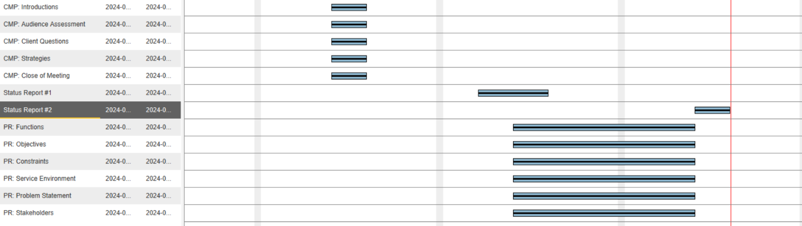
Our team is persistent in striving for success
Matthew Ting
Gantt Chart
Project Requirements assigned work progress from Jan 30th to Feb 16th

Slide 6
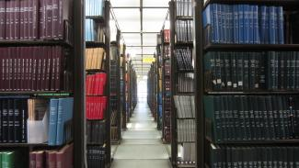
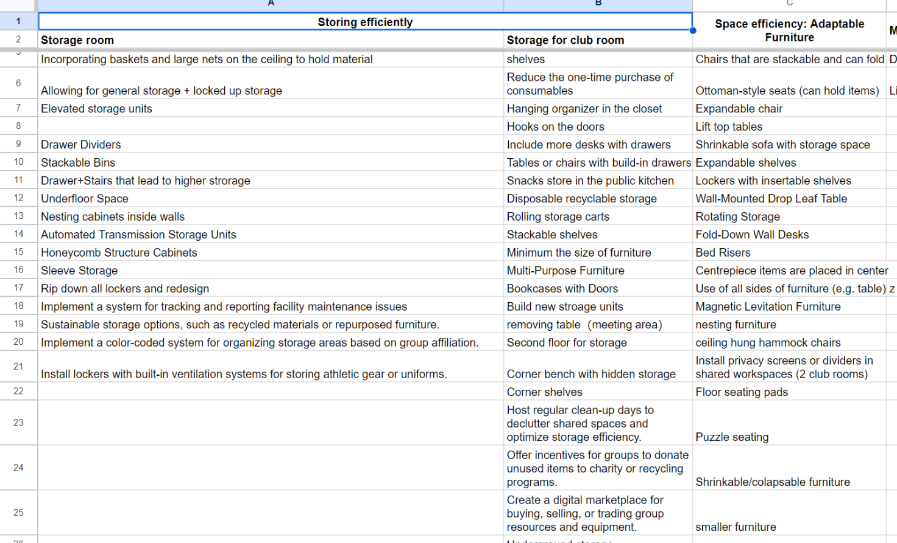
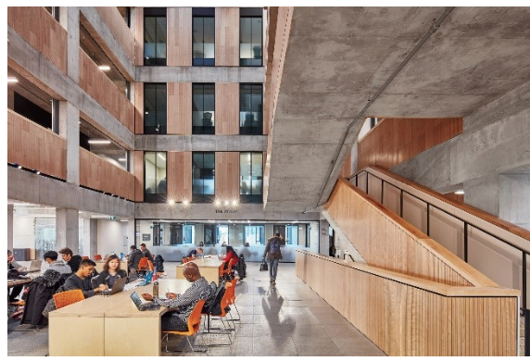
Our team is exploring the solution field through idea generation methods
Matthew Ting
Current Stage: Idea generation
Benchmarking
SCAMPER Table

Slide 7
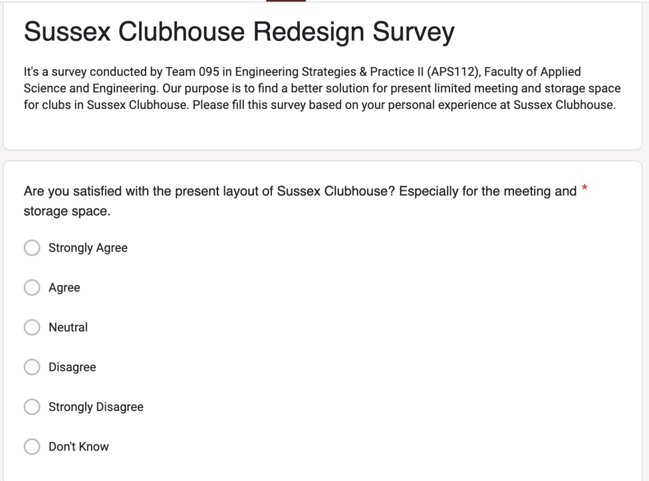
Our next milestone is to finalize a solution
through a series of idea selection methods
Dora Lyu
1
Feasibility Chart
70-50
2
Multivoting
50-30
3
Weighted Pugh Chart
30-3-1
Notes:
Feasibility Chart
Screening for viable ideas in idea generation
Multivoting
Vote and keep the feasible one
Weighted Pugh Chart
Weigh the value of elected solutions with objectives
As for future stages, our team is coming to the next stage of idea generation. We’re planning to give out a survey, aiming to ask for club students’ personal idea of the present design and suggestion on the future design. After we’re all done with the idea generation part, we’re going to use three creative methods to get the most feasible and proper solution. The first one is the use of feasibility chart, with which we can check the viability of ideas among all those impractical and magical ideas. Then we’re doing multivoting to delete the impractical ones and weigh the value of selected solutions with objectives and constraints of our projects.

Slide 8
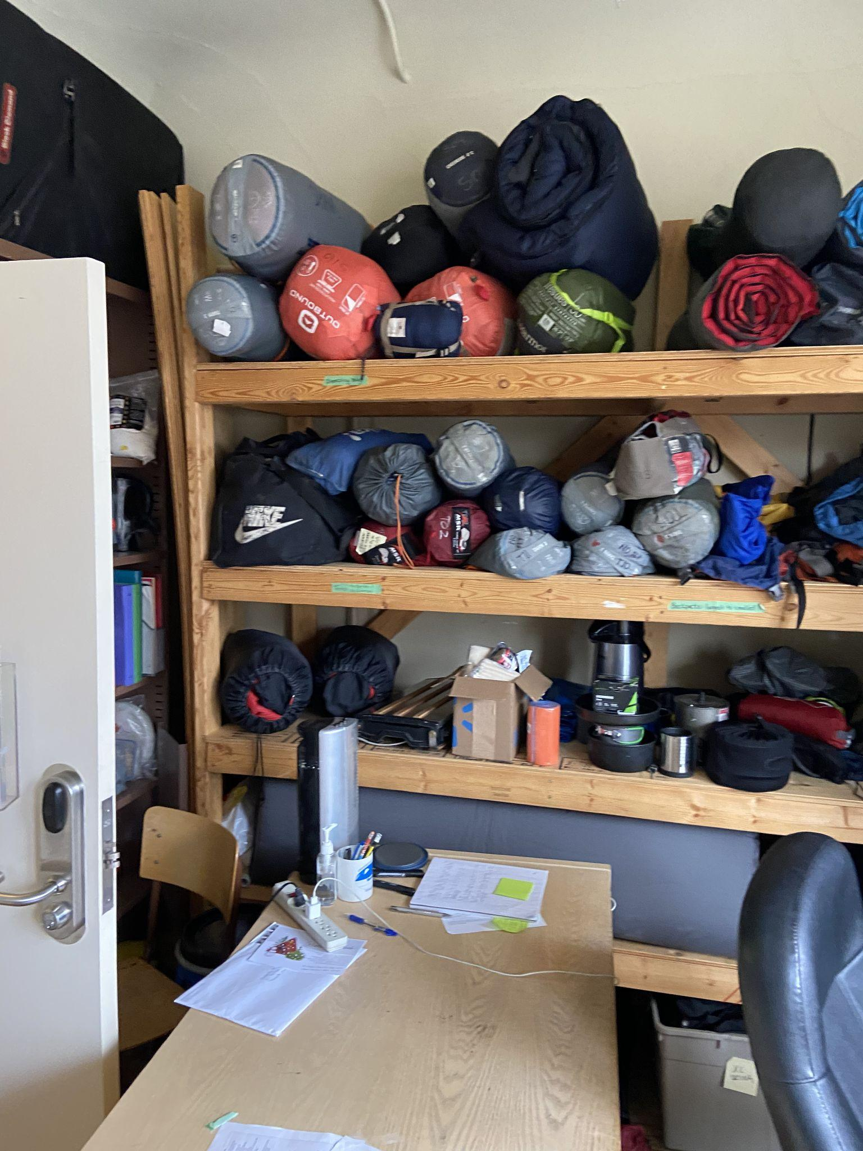
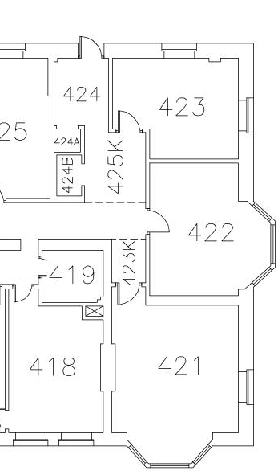
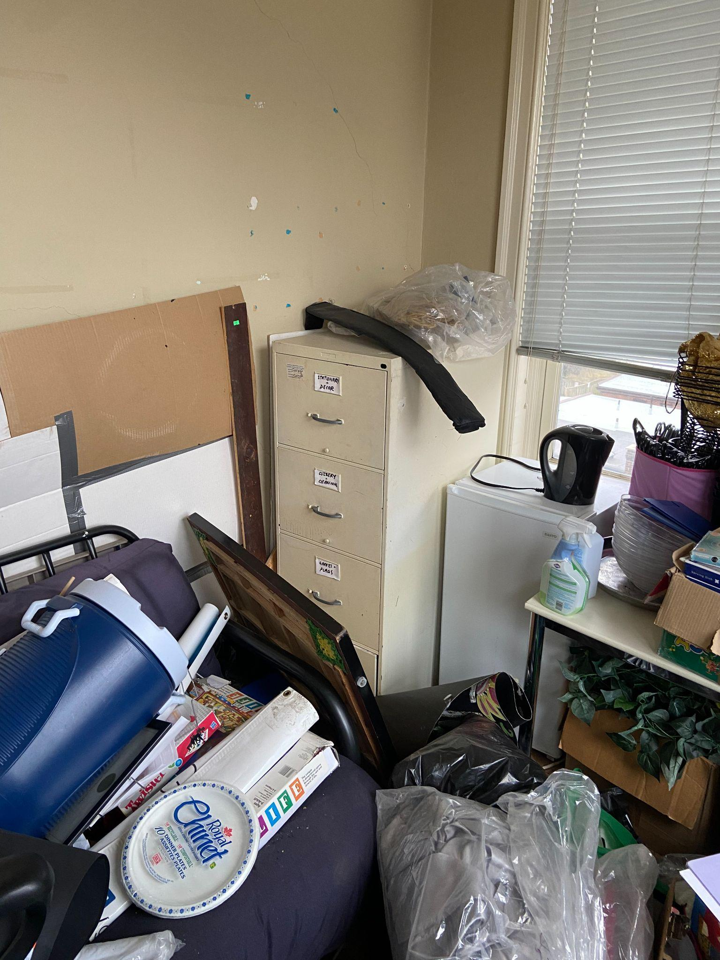
Our challenge involves developing a solution that understands and caters to the intricacies of each club and their requirements.
Chris Yip
Different Purposes
Layout
No Universal Solution
Attends to Each Clubs Needs
Notes:
Our team is currently faced with the challenge of developing a solution that understands and caters to the intricacies of each club and their requirements.

Slide 9
Our Team has taken great initiative towards the Sussex Clubhouse Space Audit
Idea Selection and Measures of Success to evaluate our design
03
Strict and Professional engineering procedure
01
02
The client has approved our Project Requirements document

Slide 10
Citation List
[1] A. Ahmed et al., “TUT0114 Team 095 First Client Meeting,” February 5, 2024
Slide 2 and 3 Images[2] A. Ahmed et al., “TUT0114 Team 095 Second Client Meeting,” March 5, 2024
[3] UTSU. “Booking Space at the Student Commons.” Accessed: March 12, 2024. Online. Available: https://www.utsu.ca/booking-spaces/
[4] Gerstein Science Information Centre. “Journal Stacks.” Accessed: March 12, 2024. Online. Available: https://gerstein.library.utoronto.ca/spaces/journal-stacks
[5] Engineering Science 2T7 Orientation. “Myhal Centre for Engineering Innovation and Entrepreneurship – MY.” Accessed: March 12, 2024. Online. Available: https://orientation.engsci.utoronto.ca/myhal-centre/

